Slide 1

PROBABILISTIC APPROACH TO MACHINE LEARNING

Slide 2
What we have seen so far
  APPROACHING SUPERVISED LEARNING BY LINEAR MODELS
  EQUATION SOLVING LINEAR ALGEBRA APPROACH TO ML
  BASICS OF PROBABILITY, RANDOM VARIABLES, EXPECTATION
  METRICS, BIAS AND VARIANCE

Slide 3

Likelihood: Intuition
Samples A,B,C,... we have with us
Probability distribution with some parameters
What is the probability that the sample A came from the probability distribution we thought of ?

Slide 4
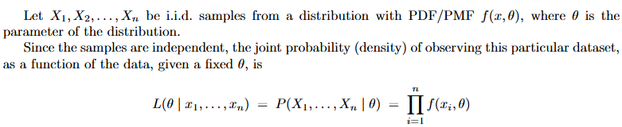
Likelihood: The Math
The likelihood function measures how plausible a specific parameter value is, given a set of observed data

Slide 5

Maximum Likelihood Estimate: Intuition
Assuming the samples came from a distribution X, then what would have been the parameters of that distribution to give these samples ?
As the name suggests we try to find the parameters that maximise the likelihood of the samples for the parameters, as computed in the previous slides
SET OF SAMPLES WE HAVE WITH US

Slide 6
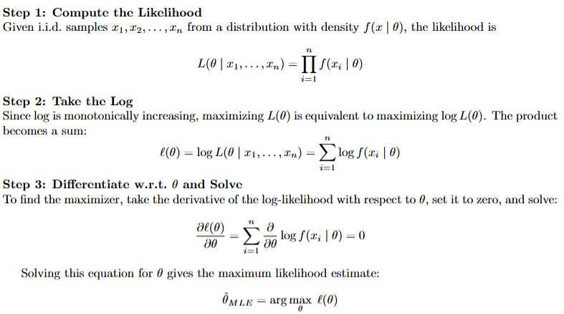
Maximum Likelihood Estimate: The Math

Slide 7
Example Problem
A coin is tossed 5 times and the outcomes observed are H, T, H, H and T. We do not know if the coin is biased or not. Assuming probability of head being p, using the method of maximum likelihood estimation, estimate the value of p.

Slide 8
Example Problem
A coin is tossed 5 times and the outcomes observed are H, T, H, H and T. We do not know if the coin is biased or not. Assuming probability of head being p, using the method of maximum likelihood estimation, estimate the value of p.
TRY OUT
What would the estimate look like for another problem but with samples from Normal Distribution ?
Here is the solution for univariate Gaussian distribution
https://statproofbook.github.io/P/ug-mle

Slide 9
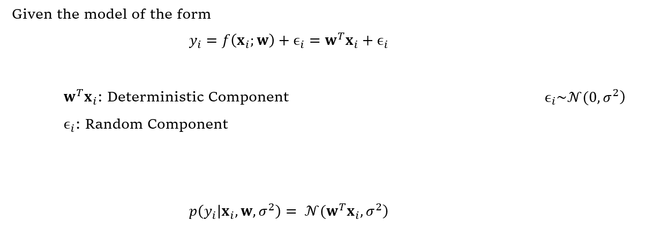
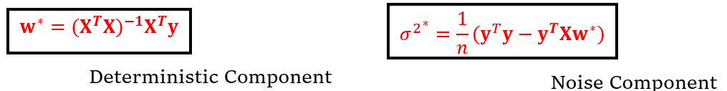
Application of MLE

Slide 10
Mean and Covariance of w*
w* is an unbiased estimator of w
Since cov(A,B) = cov(B,A)
the covariance matrix is symmetric
Try to derive these expressions using the concepts taught previously in the tutorial

Slide 11
Problems with MLE
  Ignores Prior Knowledge: MLE only looks at current data and cannot integrate historical context, known physics, or expert beliefs.
  Overfits on Small Data: 3 heads in 3 flips makes MLE conclude tails is impossible (p=1)
  MLE only provides point estimation of sample data.

Slide 12


Bayes’ Formula: Intuition
Old Belief = Prior
Fact/Evidence = Likelihood
New Belief = Posterior

Slide 13
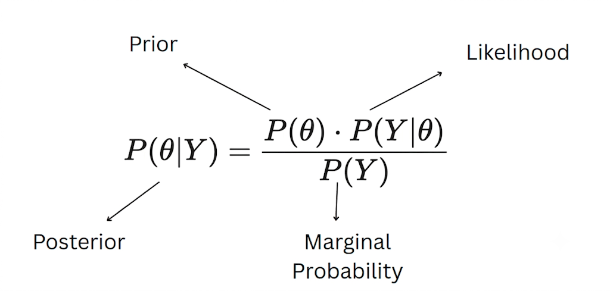
Bayes’ Formula: The Math
We can consider the denominator term
to be a scaling factor and hence we can turn this equality into proportionality and thereby continue. Hence by doing this we ignore the marginal probability in the denominator.

Slide 14
Conjugate Priors
Prior | Likelihood
Gaussian | Gaussian
Beta | Binomial
Gamma | Gaussian
Dirichlet | Multinomial
A prior distribution is said to be conjugate to a likelihood function if the resulting posterior belongs to the same distribution as that of prior

Slide 15
References
https://www.statlect.com/fundamentals-of-statistics/
A First Course in Machine Learning by Simon Rogers
Course LMS Slides

